Slide 1
CSRF 2 Lab

Slide 2
CSRF 2 Lab
Materials needed
Kali Linux Virtual Machine
Windows 7 Virtual Machine
Software tool used (from Kali Linux)
Wireshark (Network Monitoring Tool)
DVWA (Web Application)

Slide 3
Objectives Covered
Security+ Objectives (SY0-501)
Objective 1.2 – Compare and contrast types of attacks
Application/service attacks
Cross-site request forgery
DHS CAE Units
CTH – Describe different types of attacks and their characteristics

Slide 4
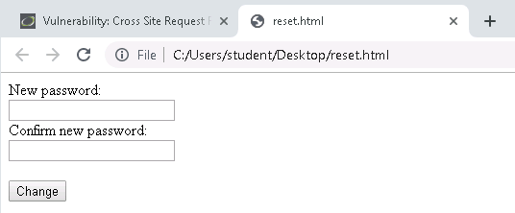
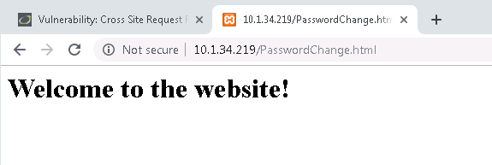
What is a CSRF Attack?
Cross-Site Request Forgery (CSRF or XSRF) attacks hijack and reuse requests from an authenticated user
Can be transmitted via an image tag, HTTP requests, hidden requests, etc.
User rarely has any idea the attack/request has even happened
An attacker can change log-in credentials, transfer ownership, gain access to private data, transfer money or resources, etc.

Slide 5
The CSRF Lab
Setup Environments
Find the IP Addresses
Log into DVWA
Change the Password
Capture the Password Change
Create New Request Form
Play the Victim

Slide 6
Setup Environments
Log into your range
Open the Kali Linux and Windows 7 Environments
You should be on your Kali Linux Desktop
You should also be on your Windows 7 Desktop

Slide 7

Find the IP Address (Kali Machine)
You will need the IP address of the Kali machine
Open the Terminal
In the Linux VM, open the Terminal and type the following command:
hostname -I
This will display the IP Address
Write down the Kali VM IP address
The IP Address

Slide 8
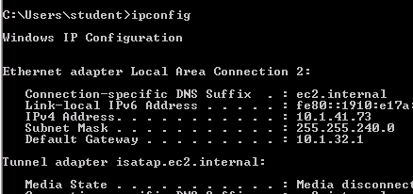
Find the IP Addresses (Windows Machine)
In Windows, open the Command Prompt
Select the Start menu
Search for “cmd”
Select the Command Prompt
Find the Windows IP Address
ipconfig
Write down the IP Address
Windows IP Address

Slide 9
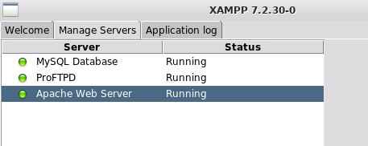
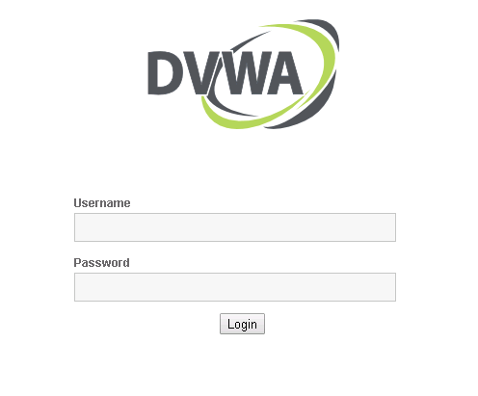
Log into DVWA
Start up the web servers (on the Kali machine)
If you used the DVWA Setup Lab, use the following command to start XAMPP (then start/restart all the servers):
sudo /opt/lampp/./manager-linux-x64.run
On the Windows Machine, go to the DVWA webpage
http://<Kali-IP-Address>/dvwa
Login credentials are admin/password

Slide 10
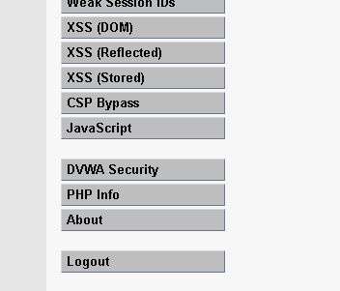
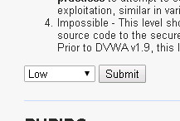
Log into DVWA
DVWA Security option
Login using the following credentials
Username: “admin”
Password: “password”
Click on the “DVWA Security” option
Change the Security Level to Low
Select Submit
This lowers the DVWA security to the lowest setting
Set to Low

Slide 11
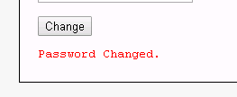
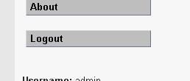
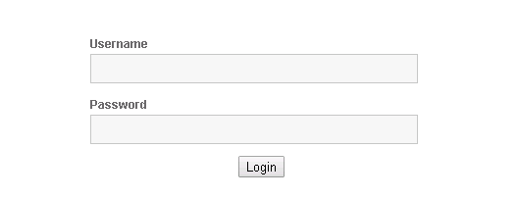
Change the Password
Password changed notification
Click on the CSRF option
Here, you can change the password
Reset the password (don’t forget it!!)**
You will receive a “password changed” notification
Logout of DVWA
Log back in using “admin” and the new password
Click to logout
**If at any point you forget the password, go here:
www.<Kali-IP-Address>/dvwa/setup.php
Click “Create/Reset Database” to reset password
Log back in with new password

Slide 12

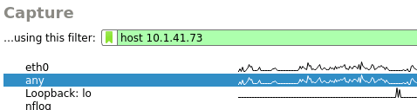

Capture the Password Change
Windows IP Address
In Kali, open a Terminal
Open Wireshark with the following command
sudo wireshark
In the “…using this filter:” option, type
host <Windows-IP-Address>
This will only find packets from the Windows machine
Select the “any” network below
Click on the blue fin to start capturing packets
Select “any” network
Blue fin to start capturing packets

Slide 13
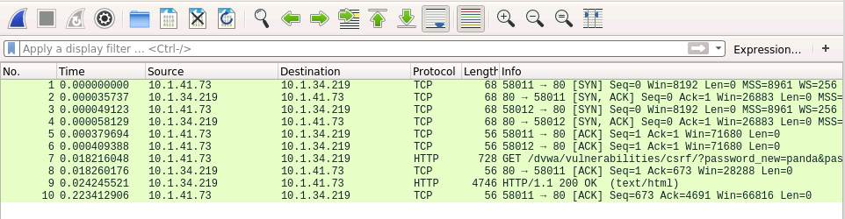
Capture the Password Change
In the Window’s browser, reset the DVWA password
Go back to Kali, and press the red button to stop the packet capture
In the packet capture, look for the HTTP request with “GET” in “Info”
Look for this packet

Slide 14
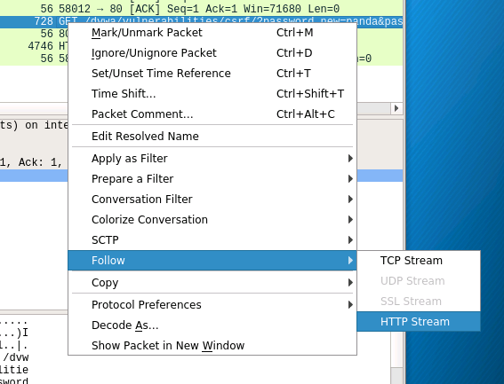
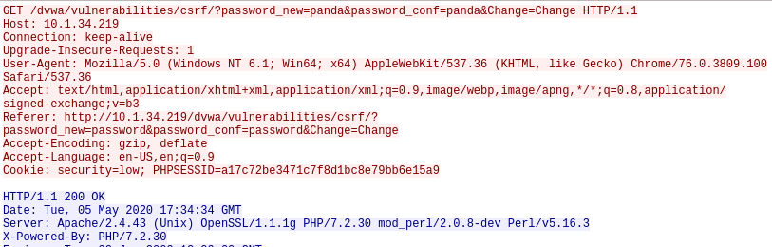
Capture the Password Change
Right-click on the packet
Select the “Follow” option
Select the “HTTP Stream”
This will open this HTTP Stream
Follow the HTTP Stream
The HTTP Stream

Slide 15
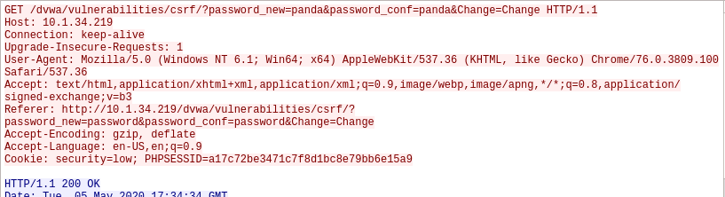
Create New Request Form
Notice you should be able to see the new password
Find the “GET” line
What the new password was set to
The “GET” line

Slide 16
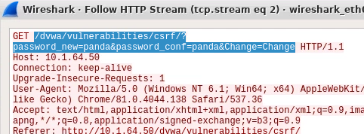
Create New Request Form
Copy all the text after “GET”
From “/dvwa/” to the second “Change”
Now, reuse this request on a new webpage
Select all of this

Slide 17
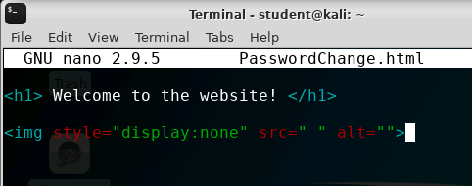
Create New Request Form
In Kali, open a new Terminal
Create a new html file named “PasswordChange.html” (and open nano editor)
nano PasswordChange.html
Write out the following HTML code:

Slide 18
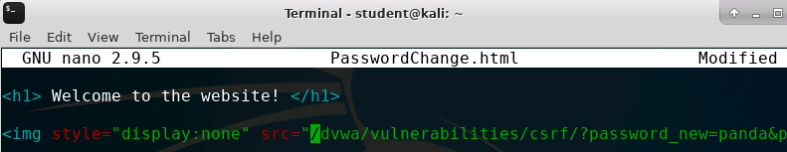
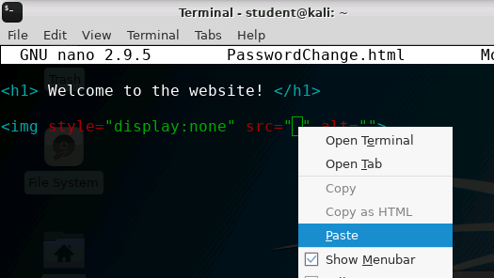
Create New Request Form
In between the quotations after src =, paste in the link from the Wireshark capture
The link pasted in
Paste in the link copied

Slide 19
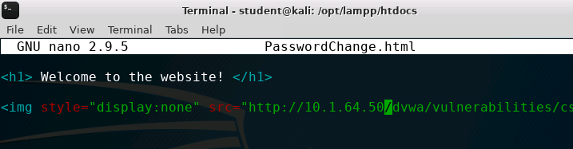
Create New Request Form
Now, add the following to the start of the link you just pasted:
http://<Kali-IP-Address>
http:/<Kali-IP-Address> before the “/dvwa”

Slide 20
Create New Request Form
In the link pasted, change the following
After “password_new=“, change “password” to “NewPassword”
After “password_conf=“, change “password” to “NewPassword”
This will reset the password to “NewPassword”
Changed

Slide 21

Create New Request Form
Save the file
CTRL+X to exit
Press Y to save
Press <ENTER> to keep the name
Move the file to the web server files
sudo mv PasswordChange.html /opt/lampp/htdocs/
This is the default directory for files for XAMPP
If not using XAMPP, this will need to be a different location

Slide 22
Play the Victim
In a Window’s browser, have a tab logged into DVWA
In another tab, go to the following website
http://<Kali-IP-Address>/PasswordChange.html
You should see the following website

Slide 23
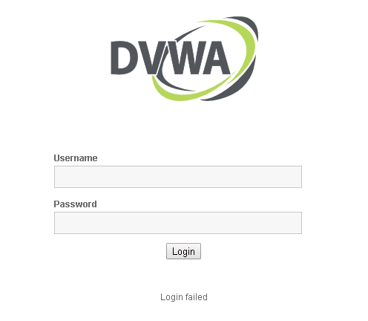
Play the Victim
What is actually happening?
Log out of DVWA in the other tab
Try to log back in
What are the login credentials?
Username: admin
Password: NewPassword
When the webpage was loaded, it also changed the password
Does the user loading the webpage see the password changed?
Password has been changed

Slide 24
Play the Victim
What happened? Take a look at the HTML code again.
<h1> Welcome to the website! </h1>
<img style="display:none" src=" <COPIED REQUEST> " alt="">
This just displays a message Makes webpage appear to actually be doing something
Show an image
But don’t display the image
Where to get the image from
(This runs the request)

Slide 25
Play the Victim
What happened? Take a look at the request
http://10.1.34.219/dvwa/vulnerabilities/csrf/?password_new=NewPassword&password_conf=NewPassword&Change=Change
New Password
The URL to submit the request
Confirming the new password
Change the password

Slide 26
Defend Against CSRF Attacks
Do not leave sessions opened
This attack would not have happened if the user was not logged into the DVWA website application on the other tab
Use SameSite Cookies
Don’t allow cookies to be used on external websites
Verify the origin of the request
Determine where the request is coming from
Never rely on GET requests for sensitive data
What are some other ways of defending against a CSRF attack?

